Slide 1



PARENT & FAMILY
INFORMATION SESSION
M. R. Hollis Innovation Academy
Dr. Adib Shakir
August 1, 2025

Slide 2



AGENDA
Welcome
Meet Our Support Team!
Academic Family Partnership
Title I: Family Engagement
Navigating Parent Portal
News You Can Use!
NEW ELA Curriculum
“No Cell Phone” Policy
Building Parent Connections
Goal Setting with Parents
“Behind every young child who believes in themselves is
a parent who believed first.”

Slide 3


Dr. Adib Shakir
Principal
Ms. Annique McMillan
Assistant Principal
MEET OUR
LEADERSHIP TEAM
Ms. Natasha Clarke-Grant
Assistant Principal
Ms. Ebony Fulgham, Ms. Iesha Fambro, and Ms. Tamayra Watson
Instructional Coaches
Ms. Courtney Gaines
Ms. Allaenna Williams
School Counselors
Dr. Charlotte Sanford
Exceptional Education Lead Teacher
We lead the school so our students can one day lead the world!

Slide 4

MEET OUR
FAMILY ENGAGEMENT
& STUDENT SUPPORT
STAFF
Ms. Yashica Burnett
Parent Liaison
Ms. Ebony Scott
Ms. Lakecia Berry
Social Workers
Ms. Shaunya Reeves
Communities in Schools
Ms. Adella Dixon
MTSS
It truly
takes
a village!

Slide 5


ACADEMIC FAMILY PARTNERSHIP
“When schools and families partner with purpose, students thrive in every direction.”
Question: What is academic family partnership?
Answer: Academic family partnership is the mutual responsibility between our staff and families to
work together on behalf of students.
UNDERSTAND YOUR STUDENT’S DATA
UNDERSTAND THE ACADEMIC GOALS
BUILD MEANINGFUL RELATIONSHIPS
To know where we’re going, we must understand where we are.
Student performance data, like MAP scores, gives us an idea of where your student is right now.
Teachers set goals for students. Parents do too!
Talk about this year’s goals with your student’s teacher(s).
With data & goals in mind, schools & families can create stronger connections.
Every connection is an opportunity to partner with purpose!

Slide 6

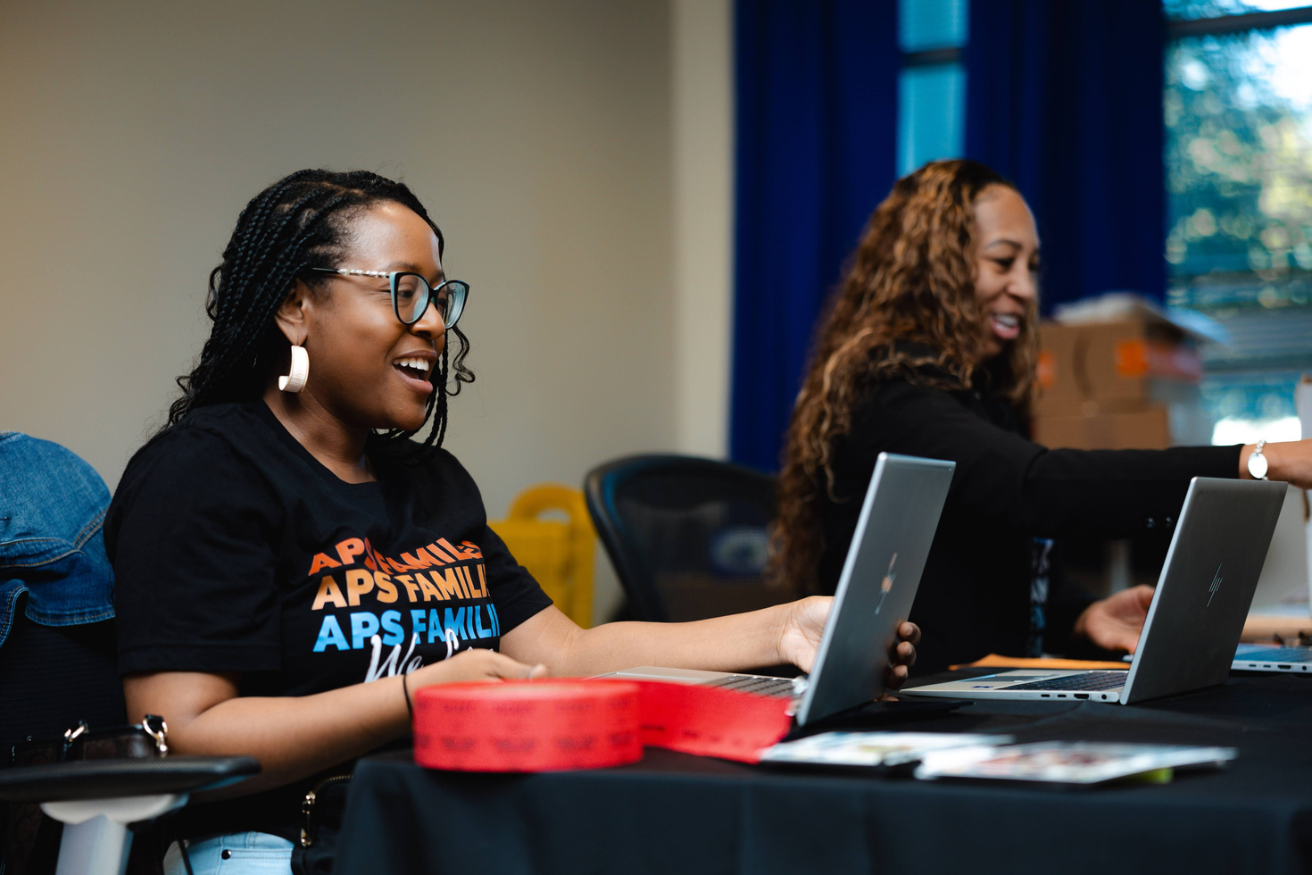
TITLE I
A federal program that gives extra funding support to schools so all students,
especially those who need the most help, can succeed!
SCHOOL & PARENT
Grab
your copy of the three Title I documents today!
FAMILY ENGAGEMENT PLAN
Our Title I Family Engagement Plan explains how the school will work with families to support student success.
SCHOOL & PARENT
COMPACT
The School-Parent Compact is an agreement between families and schools. It says we ALL will work together to help kids do their best.
Our school must have parent signatures to approve the compact. Don’t forget to sign your copy!
DISTRICT & PARENT
FAMILY ENGAGEMENT STATEMENT
The APS Family Engagement Statement shares goals for working closely with families. APS sends this plan to the Georgia Department of Education (GaDOE).
Notes:
1. School & Parent Family Engagement Plan: Includes activities for family involvement and is part of the school’s overall plan that is submitted to the district.
2. School & Parent Compact: The compact shares ways our school and our families can partner to help students meet their learning goals.
3. District & Parent Family Engagement Statement: It includes district activities that help strengthen family-school partnerships.

Slide 7

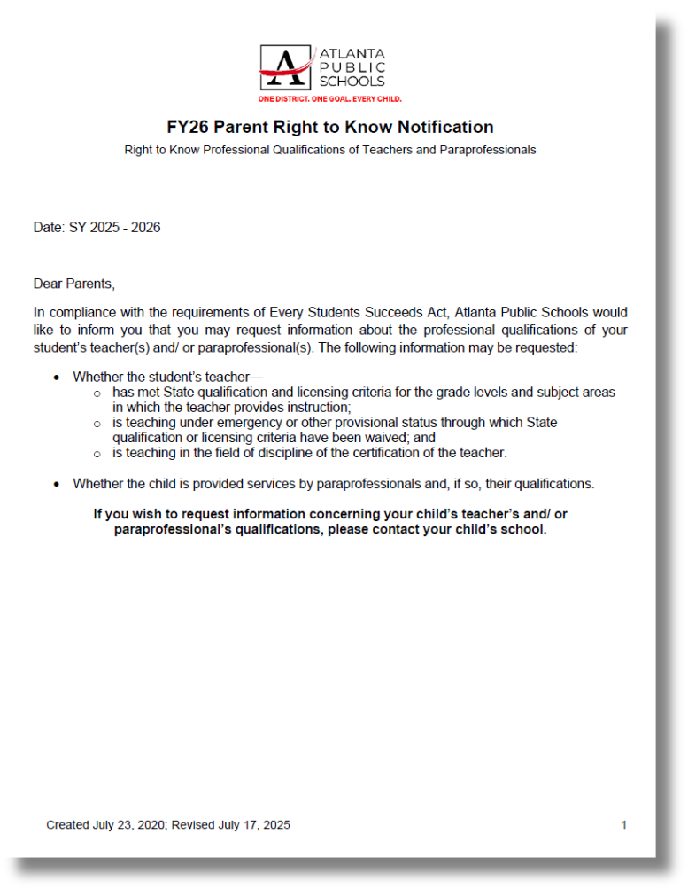
PARENT
RIGHT-TO- KNOW
This letter informs you of your right to ask about your child’s teacher’s qualifications—like if they’re certified in Georgia, what degrees they have, and if they’re teaching with special approval.

Slide 8


NAVIGATING THE
CAMPUS “PARENT PORTAL”
tinyaps.com/?portal

Slide 9

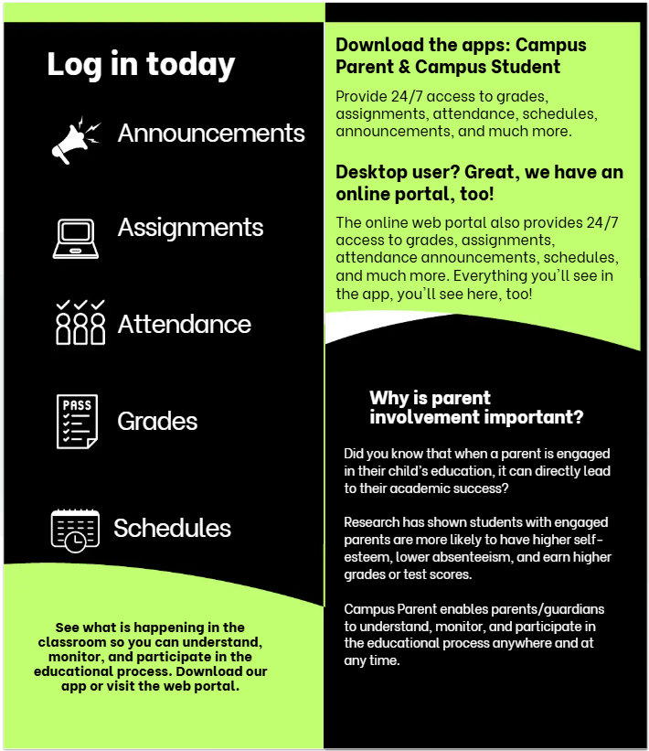

NAVIGATING THE
CAMPUS “PARENT PORTAL”

Slide 10
NEWS
YOU CAN USE!
What’s happening around our school & APS!

Slide 11
CURRICULUM UPDATES
NEW ENGLISH LANGUAGE ARTS STANDARDS
UPDATES
What Families Need to Know
Georgia students will begin learning from
new English Language Arts (ELA) standards.
From Kindergarten through 12th grade, students will be building stronger skills in reading, writing, speaking, and listening.
Teachers will use one of these high-quality ELA curriculum programs:
Benchmark Advance -or- HMH Into Reading
The new material is designed to be fun, challenging, and welcoming for all learners!
APS is here for you!
The Curriculum and Instruction Team, “CANDI”, is committed to
helping every child succeed.

Slide 12
CURRICULUM UPDATES
NEW ENGLISH LANGUAGE ARTS STANDARDS
UPDATES
Tips for Families to Support ELA at Home
  Read Together: Read books, news articles, or stories. Ask questions about what they understood or liked best.
  Writing Practice: Short stories, journal entries, or even thank-you notes. It builds confidence and creativity.
  Talk About Their Day: Ask them to explain something they learned using full sentences.
  Listen to Audiobooks or Podcasts: This builds vocabulary and helps them hear how ideas are shared clearly.
Ask a staff member about our school’s ELA program and how YOU can
reinforce learning at home.

Slide 13


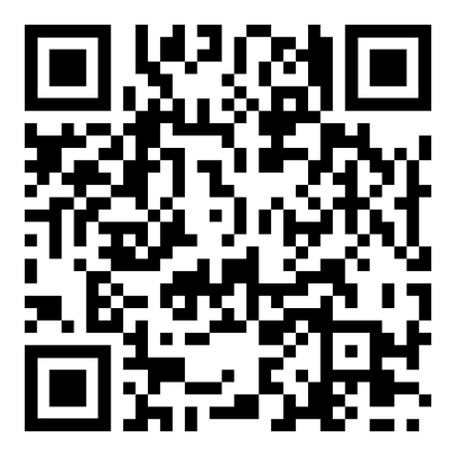
2025 - 2026
STUDENT HANDBOOK
Notes:
Link to Handbook: https://www.atlantapublicschools.us/domain/94

Slide 14


PED POLICY (PERSONAL ELECTRONIC DEVICE)
PROHIBITED USE OF CELL PHONE
Code 14F, APS Student Handbook, pg. 57
Students PreK - 12 are not allowed to use cell phones during the school day, once the bell rings. This includes class time, hallways, lunch, recess, assemblies, and free periods.
All personal devices must be turned off and kept out of sight.
If a student wears a smart watch or smart glasses to school, the device can not be used to make/receive calls. If a student uses a smart watch or smart glasses to make calls the rule will apply.
Exception: Students with an approved IEP, 504, or medical plan may use a phone only if it’s clearly required in their plan.
What Happens If a Student Breaks the Rule:
  First time: Verbal warning
  Second time: Phone is taken and returned only to a parent during a meeting
  Third time: Phone taken + no phone allowed at school for one semester
  Fourth or more: Phone taken + no phone allowed at school for one year
Page 57
of the
Handbook

Slide 15


MANAGE YOUR STUDENT’S ACTIVITY ON THE
SECURELY PARENT APP

Slide 16

FIND COMMUNITY RESOURCES ON
APS CARES
Use apscares.findhelp.com
to search resources in your Zip Code:
housing, financial assistance, mental health,
childcare, employment, legal support
and more!

Slide 17
How to Volunteer
UPCOMING VOLUNTEER
For student safety, APS requires schools to identify and screen ALL volunteers.
  Security clearances for volunteers must be renewed every two years.
  Volunteers must wear their printed “volunteer” badge at all times while on school property.
  All volunteers must complete and sign a Volunteer Release Form.
OPPORTUNITIES
Tuesdays: Clothing Closet with Mrs. Burney-Mitchell
Thursdays: Garden with Mrs.Colbert& Dr.Zimmerman
Monthly: Bulletin Board Support

Slide 18

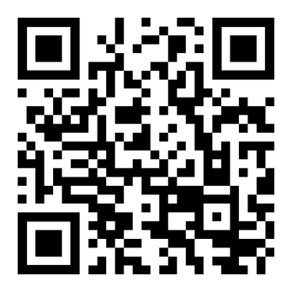


JOIN A
PARENT NETWORK
The APS Family Engagement Office will host opportunities for parents to connect & grow:
  Workshops to help you support your student!
  “Town Halls” to talk about school important topics!
Scan the QR code to get a
Parent University
invitation!
Are YOU interested in being a
Parent Ambassador?
The APS Family Engagement Office is recruiting parents to:
  attend 4 virtual meet-ups
  network with parents across APS
  give input on APS strategies
Scan the QR code to get
Parent Ambassador
information!
Parent Teacher Association
Parent Teacher Organization
PTA/PTO is a great way to show your school support!
The PTA/PTO assists with:
  community building
  fundraising
  special events
  bringing resources to the school
  supporting teachers & staff
  advocating for students & families and much more!
PARENT
UNIVERSITY
PARENT
AMBASSADOR
TEAM
PTA / PTO
Notes:
https://forms.gle/SATybYPjW46rmaQ37

Slide 19



DIGITAL ENGAGEMENT:
PARENT COMMUNICATION TOOLS
Our school uses digital tools to communicate with families throughout the year:
  Class Dojo

Slide 20
GOAL SETTING
Parent Tips
YOU can help your student achieve their Academic & Attendance goals:
ACADEMIC & ATTENDANCE
Connect with your student’s teacher(s). Keep the connection strong all year!
Our school has a
Continuous Improvement Plan, “CIP”.
The CIP outlines our goals for
student achievement.
Teachers also have specific targets
for each grade level & content area.
Schedule at least 2 Parent Teacher Conferences this year.
Try not to miss school (unless ill).
Each absent day of school is an opportunity for your student to fall behind.
Parents have goals too!
Let our teachers know what your goals are
for your student.
Notes:
Talk about the school’s academic goals and attendance goals for students.
Talk about the family engagement action steps. This is an FYI for parents to help them understand their role in student achievement.

Slide 21
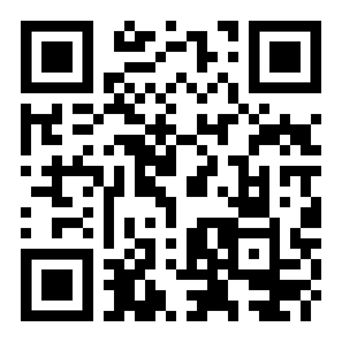

$50 GIFT CARD PRIZES
ALWAYS TELL US
HOW WE’RE DOING!
ANSWER THESE 3 QUESTIONS ON
THE FEEDBACK FORM & YOU MAY WIN!
Through out the school year we welcome your feedback.
Parents are partners
and your input is crucial to ensure we are giving students their best chance for success!
Look out for the
APS Family Engagement Survey later this Fall.
Was the information in this presentation helpful to you as a parent/caregiver?
Do you understand how to keep track of your student’s learning goals & progress?
Do you know where and how to access the parent resources we shared today?
Scan me

Slide 22


THANK YOU
“When parents are engaged, great things happen.”

